Slide 1


Workforce Recruitment Program

Slide 2
What is WRP?
The Workforce Recruitment Program (WRP) is a recruitment and referral program that connects federal and select private-sector employers nationwide with highly motivated college students and recent graduates with disabilities.
WRP is managed by the U.S. Department of Labor and the U.S. Department of Defense.

Slide 3
Goals of the Program
Bring students with disabilities into the employment process.
Help college Career Centers and Disability Services Offices connect with their students with disabilities around employment.
Function as a pipeline to bring new talent into the Federal Government and fill mission-critical jobs.
Break down attitudinal barriers in the workplace.

Slide 4
Important WRP Dates
Student registration opens: Monday, August 22
Student registration closes: Thursday, October 13
Student applications close: Sunday, October 16
Informational interview period: Monday, October 24 – Wednesday, November 16
Database released to employers: Mid-December

Slide 5
Who can participate?
Students and recent graduates with disabilities. All applicants must be:
eligible for the Schedule A Hiring Authority for persons with disabilities
a U.S. citizen
Current students must be an enrolled full-time, degree-seeking, postsecondary (undergraduate or graduate) student. If you are taking a reduced course load due to a disability, the COVID-19 pandemic, or are in your last term/semester, you can also apply.
Recent graduates must have met the above requirements while enrolled and have graduated with a degree on or after April 1, 2020.

Slide 6
What is Schedule A?
Schedule A is a hiring mechanism for people with disabilities that allows them to be quickly hired into the federal workplace.
  Improves the Federal Government’s ability to hire.
  Helps the Federal Government be a model employer.
Candidates are eligible for Schedule A if they have an intellectual disability, psychiatric disability, or severe physical disability.
To be hired, candidates with disabilities must be qualified for the position and provide a Schedule A letter to HR.
Learn more: Schedule A Hiring Authority and How to Obtain a Schedule A Letter

Slide 7
Who can provide a Schedule A Letter?
A Schedule A letter is documentation that you are Schedule A eligible. This letter must be on letterhead and signed by:
A licensed medical professional;
A licensed rehabilitation professional; or
Any federal or state agency that issues or provides disability benefits.
This letter does NOT need to detail your specific disability, medical history, or need for accommodation. Follow the sample Schedule A letter language.

Slide 8
WRP and Schedule A
WRP candidates must certify that they are eligible for Schedule A when they register on WRP.gov.
WRP Employers use Schedule A to hire WRP candidates into internships and jobs at their agencies.
Candidates must provide a Schedule A letter to the federal agency’s human resources if accepting a WRP opportunity.
Have your letter on hand by January 2023 to provide to an agency’s HR if requested. Otherwise, you could delay or lose job opportunities and frustrate your potential employer.
Do not upload your letter to WRP.gov but have it ready!
8

Slide 9
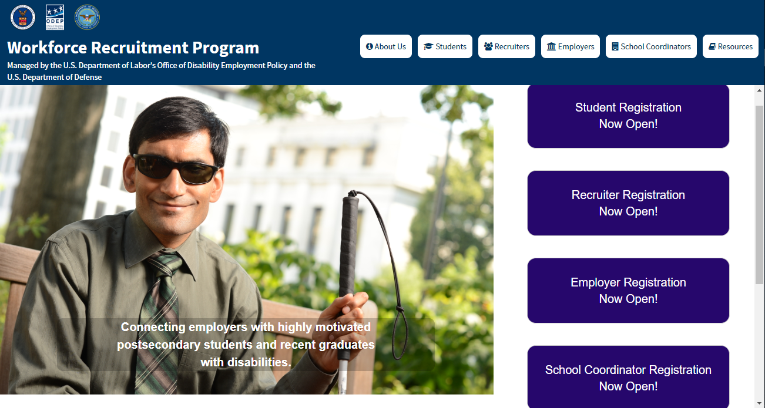
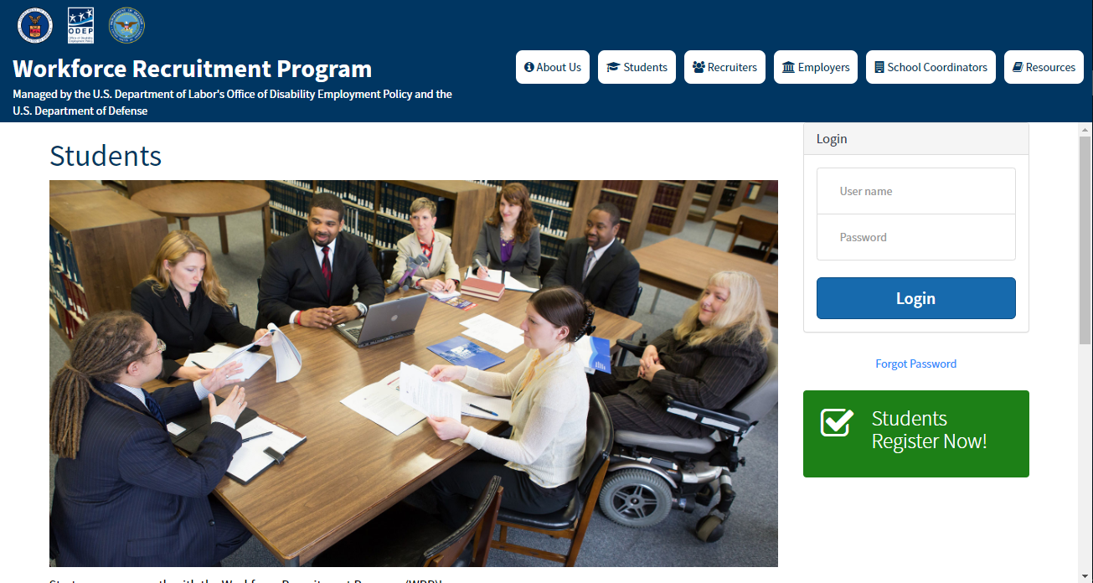
Register at WRP.gov
To register for the WRP, students will need to visit WRP.gov.
Use Chrome or Firefox on a computer (not a mobile device).
Select the first purple box that says, “Students Registration Now Open!” Then, click the green “Students Register Now!” button.

Slide 10
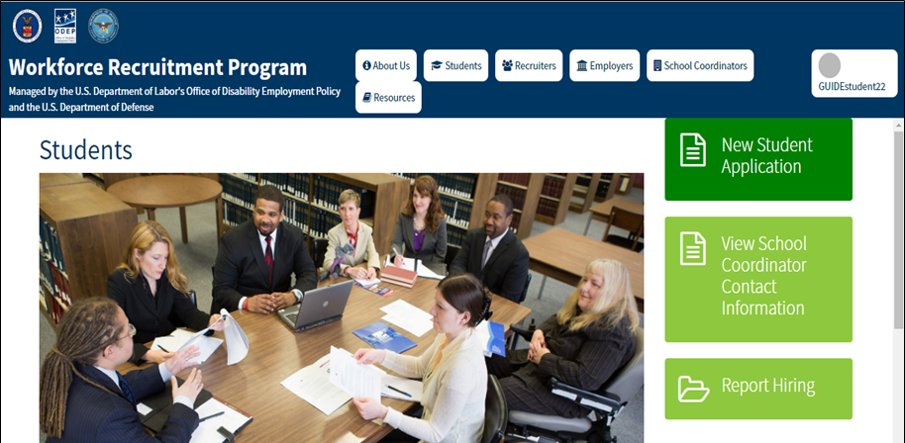
Student Registration Steps
Click the registration button, then complete the Rules of Behavior, Agreement, and Registration forms.
Once your School Coordinator approves your registration, you will receive an email with information about how to create or sign into your Login.gov account, which you will use to log into WRP.
After you set up your login for the first time, you will be directed to your student homepage.
Click New Student Application to get started!

Slide 11
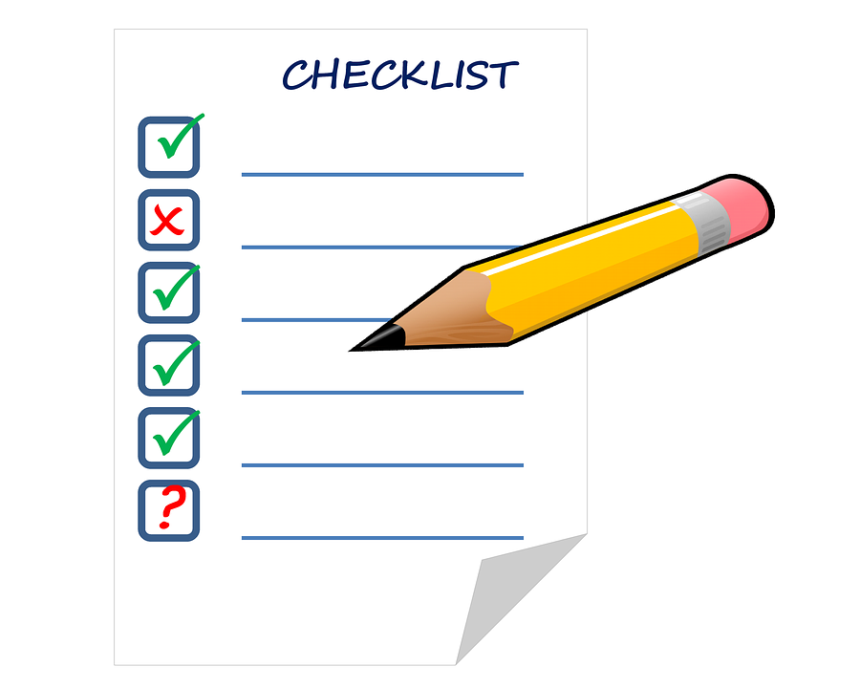
Required information for the WRP Application
The WRP student application consists of:
Identification and contact information
Resume
Transcript (official or unofficial)
Academic information including major, degree, GPA, etc.
Job and location preferences
Disability & demographic info (for statistical purposes only, not shown to employers)
Optional: Cover letter, letter of recommendation, writing sample, etc.
Do not upload information that contains your social security number, date of birth, or other sensitive personally identifiable or health information.

Slide 12
Informational Interviews
WRP applicants can receive an elective informational interview with a WRP Recruiter, who is a Federal Government employee.
You will have a conversation where you ask for career advice and learn about federal service.
Recruiter will provide feedback and general suggestions on your resume and application
This is your chance to learn and seek advice from a federal employee about how to succeed in your future career path.

Slide 13
Preparing for Your Interview
Review your resume with Career Services before uploading it to WRP.
Create a list of general questions to ask your Recruiter about federal service and career advice, and practice with your Coordinator or a peer.
Research federal careers and agencies. Be aware that your Recruiter may be in a different career field, so be flexible in your questions.

Slide 14
Preparing for Your Interview (2)
Be ready to receive resume feedback during your interview.
Be prepared to answer questions related to your academic, professional, and extracurricular experiences.
Give highlights of your successes and discuss how you solve problems.

Slide 15
After the Interview
Your application is published to federal employers from December 2022-December 2023.
Keep your WRP application and contact info up to date all year so employers can contact you! You can edit your application and documents even after submitting.
Please note: WRP is not a guarantee of employment, and we encourage you to pursue other avenues in addition to WRP.

Slide 16
How Employers will Contact You
Employers will contact candidates directly by email or phone. (WRP and your Recruiter do not track this information.)
Employers may contact candidates about jobs as early as January, and will continue through June for summer jobs, and up to one year for permanent jobs.
If you are contacted with a job or interview offer, get the person’s contact information. Ask about the location of the position, the job title, and job duties.

Slide 17
Questions?
Email or Schedule a Teams Meeting
blockm3@wpunj.edu OR arc@wpunj.edu
Or Call: 973-720-2853

